Slide 1
Understanding Memory SQL Server and Azure SQL
Bob Ward, Principal Architect, Microsoft Azure Data
https://aka.ms/bobwardms

Slide 2
What’s in this presentation?...
The SQL Server Memory Architecture
Configuration Choices and Memory Accounting
Dynamic Memory Management
Other Memory Topics
SQL Server on Linux, Containers, and Kubernetes Memory
Azure SQL Memory

Slide 3
The SQL Server Memory Architecture
SQLSERVR.EXE
Caches
Buffer Pool or BPool
(Database Pages)
In-Memory OLTP
Grow, shrink, “backing store”
Fixed Memory
Grow, shrink when not used
Memory objects
No “backing store”
Connections, Memory Grants, …
Plan Cache
Other Caches and Pools
Thread Stacks, …
Columnstore
“Fixed” Memory
Fixed memory for HK
Grows but has limits
Can’t shrink if data
Deleting data = reclaim (GC)
SQLSERVR.EXE overhead

Slide 4
Paging and SQL Server
SQL Server can do its own “paging”
Buffer Pool database pages to database files
Free up plan cache pages and reload from system tables
Some memory is not pageable (Ex. Connection Memory)
Windows can page out any process memory
Write out windows pages to pagefile
Working Set Trim
SQL still thinks it is all in RAM
Can be thread stacks
Seen via Process:Working Set
Seen via Memory:Pages Output/Sec

Slide 5
Memory Configuration Decisions
Memory Model
Conventional – Default
Locked Pages – Std/EE and “Locked Pages in Memory” privilege.
Large Pages – Trace Flag 834. Allocate up front. Use –T876 with columnstore
‘max server memory’
0 means min((95% of physical RAM), (50% of available RAM))
Ceiling to which SQL will not grow above = Target
Many choose on larger servers to be !=0 and < physical RAM
External pressure may cause us to lower the ceiling dynamically (but doesn’t change the configured value)
‘min server memory’
Floor to which SQL will not shrink below
We don’t allocate to min at startup
Multi-instance configurations
They don’t know about each other
VirtualAlloc
AWE
VirtualAlloc (MEM_LARGE_PAGES)

Slide 6
SQL Server and “Locked”
Locked Pages Memory Model
“Locking” memory allocation to Windows won’t page it
Requires ‘Locked Pages in Memory” Privilege for the account
Not part of the process working set so can’t be trimmed
“Other Memory” (stacks, heaps) can be trimmed
Large Pages is also “locked”
SQL Memory “Locked”
Independent of “Locked Pages” memory model
‘max server memory’ is our ceiling to grow (Target)
Memory pressure could cause us to lower our ceiling
‘min server memory’ is the floor which we won’t go below

Slide 7
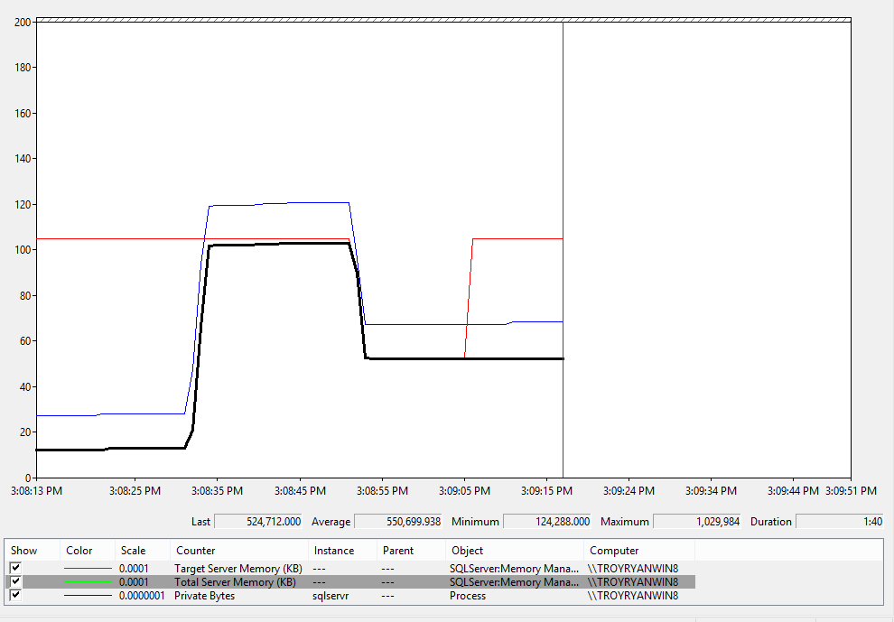
SQL Server Dynamic Memory Management
private bytes will always
be slightly higher
(ceiling)
‘max server
memory’
= 1Gb
query still running
but we hit ceiling (internal pressure)
query still running
pages in and out cache
mem pressure gone.
target back to max
total server
memory
right after
startup
query completes
Why doesn’t
total go back up?
external mem pressure
drops to min server
memory = 512Mb
(floor)
query starts
and loads pages

Slide 8
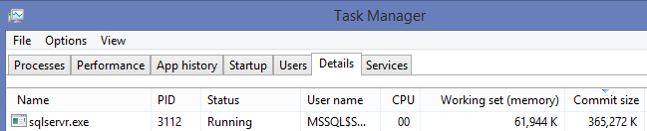
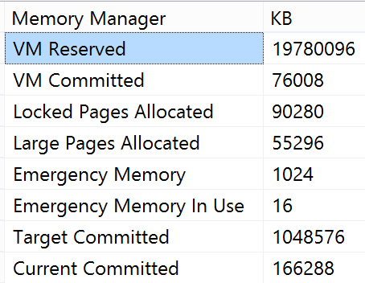

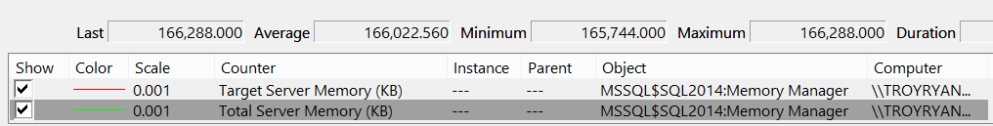
A visual look at memory accounting
DBCC MEMORYSTATUS
dm_os_process_memory
=large+locked+WS
Large can be used w/out –T834
dm_os_sys_info
perfmon

Slide 9
Dive into SQL Server Memory Management and Accounting
Demo
Notes:
Dynamic example
Break the server by setting max to 128Mb. Show the ERRORLOG and how to use –f to get out of jail
Use the debugger to show the layers

Slide 10
Other Memory Topics
Buffer Pool Logistics
Page Life Expectancy
PAGEIOLATCH waits
DBCC DROPCLEANBUFFERS
NUMA and SQL Server
Goal = use local node when allocating not node balance
Local node page allocation not a guarantee of local node access
Some memory is partitioned when created (Ex. Partitioned memory object)
Memory Grants
Fixed memory allocated at start of query execution (sorts, hashes, …)
Too low = sort spill
Too high = RESOURCE_SEMAPHORE waits and/or Plan Cache Eviction
Resource Governor to limit (now supports < 1%)
Memory Grant Feedback in 2017 and 2019
Memory Leaks
Leak within target (OOM errors in ERRORLOG, msg 701)
Private byte leak “external” code

Slide 11

Plan Cache Eviction
Major performance impact –
Buffer Pool important but it gets more memory
Memory pressure
Hitting the target
External pressure
Large Memory Grants
Cache Cap Limits
Overall cap limit
Plan cache cap limit (size, type, #entries)
“Cache Wars”
You might have caused this
DBCC FREEPROCCACHE (or other flavors)
Specific sp_configure change
External clock hand
Internal clock hand
Are you smart with what you cache?

Slide 12
SQL Server on Linux, Containers, and Kubernetes
SQL Server on Linux
SQL Server engine behaves the same as Windows
SQLPAL uses memorylimitmb to provide max possible memory (default 80% of physical)
Locked pages not applicable
Linux can page to swapfile - Look out for the OOM killer
Check out our kernel tuning best practices
SQL Server Containers
Configure right amount of memory for container runtimes that require VMs
Containers by default get access to all memory
SQL Containers don’t know about each other
SQL Server and SQLPAL not aware of container memory limit configuration
Containers don’t cooperate with each other
SQL Server on Kubernetes
Configure the right amount of memory for nodes
SQL Server and SQLPAL not aware of k8s memory policies

Slide 13
Memory with Azure SQL
Azure Virtual Machine = Same as SQL Server
Memory optimized sizes have high CPU to memory ratio
Azure SQL Managed Instance
Memory limit per vCore
In-Memory OLTP only with Business Critical
Memory limits enforced by Windows Job Object
Azure SQL Database
Scaled memory limit depending on vCores for General Purpose and Business Critical
Up to 4TB with Business Critical M-Series hardware
In-Memory OLTP only with Business Critical
Min and Max memory limits for Serverless – Target can be reduced with low utilization
Memory limits enforced by Windows Job Object
Fixed memory scale with each vCore
Hyperscale = same memory limits as General Purpose

Slide 14
Memory with Azure SQL
Demo
Notes:
Show Azure SQL DMV to see memory limits
Show SQL MI, ERRORLOG, DMVs to see memory accounting

Slide 15
Learn more….
All my decks at https://aka.ms/bobwardms
Recommend updates and configuration settings article
SQL Server Memory Management Architecture in docs

